Slide 1
Tuesday, January 17TH
STAKEHOLDER ENGAGEMENT FOR DIGITIAL REGULATION
Marianna KARTTUNEN
Policy Analyst, Regulatory Policy Division
Organisation for Economic Co-operation and Development

Slide 2
The Organisation for Economic Co-operation and Development, OECD
38 members economies from around the globe
Mission: to promote policies that will improve the economic and social well-being of people around the world
Forum in which governments can work together to share experiences and seek solutions to common problems
Public Governance Committee & Regulatory Policy Committee (extensive work with non-members – MENA, SE Asia)

Slide 3
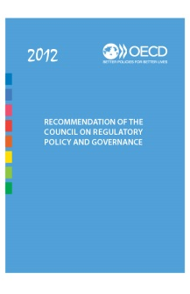
The OECD Regulatory Policy Committee
Aim: Assist countries in building and strengthening their regulatory reform efforts.
Legal instrument: 2012 Recommendation of the Council on Regulatory Policy and Governance
Evidence on implementation: Country reviews; Regulatory Policy Outlook (2015 & 2018 & 2021)
OECD (forthcoming), Best Practice Principles on Stakeholder Engagement in Regulatory Policy, OECD Publishing, Paris. https://www.oecd-ilibrary.org/sites/39416960-en/index.html?itemId=/content/component/39416960-en#
Extensive work with non-OECD countries
LAC Network on Good Regulatory Policy Practices
Southeast Asia & Good Regulatory Practice Network
OECD Accession candidates: Argentina, Brazil, Bulgaria, Croatia, Peru, Romania and Ukraine.

Slide 4
Structure of the presentation:
1. What is stakeholder engagement?
OECD guidance to date and practice across members
2. Stakeholder engagement in digital regulation:
OECD 2021 Recommendation on Agile Regulatory Governance to Harness Innovation
OECD 2022 Recommendation on International Regulatory Co-operation to Tackle Global Challenges
3. Conclusion: Critical pillars for stakeholder engagement

Slide 5
1. What is stakeholder engagement? OECD current guidance and practice across members

Slide 6
Stakeholder engagement: key pillar of regulatory quality
OECD 2012 Recommendation of the Council on Regulatory Policy and Governance
1. Explicit policy on regulatory quality
2. Communication Consultation and Engagement
3. Regulatory Oversight
4. Integrated RIA
5. Review Regulatory Stock –
ex post evaluation
6. Review performance of regulatory reform
7. The organisation of regulatory agencies
8. Administrative and judicial review
9. Risk and Regulation
10. Regulatory coherence across levels of Government
11. Regulatory management capacity at sub-national level
12. International regulatory co-operation

Slide 7
1.2 Communication, consultation and engagement: OECD 2012 Recommendation of the Council on Regulatory Policy and Governance
Adhere to principles of open government, including transparency and participation in the regulatory process to ensure that regulation serves the public interest and is informed by the legitimate needs of those interested in and affected by regulation. This includes providing meaningful opportunities (including online) for the public to contribute to the process of preparing draft regulatory proposals and to the quality of the supporting analysis.

Slide 8
But doesn’t this slow down government activities?

Slide 9
Why engage with stakeholders ? Collecting better evidence
Stakeholders can offer valuable inputs on the feasibility and practical implications of regulations.
Meaningful stakeholder engagement can lead to higher compliance with regulations, when stakeholders feel that their views have been considered.
From a regulatory policy perspective, this entails granting members of the public sufficient opportunity to help shape, challenge, and reform the regulations that they encounter in their daily lives.

Slide 10
Who to engage with? Those interested and affected by regulation
‘Stakeholders’ can potentially include citizens, businesses, trade unions, civil society organisations, public sector organisations, etc.
General guidance:
Consultation should be open and voluntary
Be specific when selecting who to consult
Revisit stakeholder analysis throughout the consultation process
Avoid over reliance on advisory bodies or expert groups
Keep in mind:
Stakeholders usually least represented (eg. new entrants, SMEs)
Potentially affected foreign stakeholders

Slide 11
How to engage with stakeholders
Scope and form of stakeholder engagement
Active Participation
Agency Citizens
Partnership
Consultation
Two-way flow
Agency Citizens
Obtaining information and public views
Identifying conflict lines
Verifying consistency and acceptance
Complementary
Information/
notification
One way process
Agency Citizens
Providing information

Slide 12
When to engage with stakeholders? Throughout the regulatory policy cycle

Slide 13
Practice across OECD members: Insights from 2021 OECD Regulatory Policy Outlook
KEY FINDINGS
The development of laws would benefit from a more integrated approach to stakeholder engagement.
Stakeholders can help improve policies if they are better informed about upcoming consultations and evaluations.
Citizens are more likely to view regulations as fair if they are engaged in the process and the outcomes of consultations are clearly explained.
Policies could be improved by considering the full suite of alternative policy options.
OECD members are increasingly proportionate in their depth of analysis.
OECD members now consider a broader range of impacts, but competitiveness impacts remain incomplete.
The growth in availability and use of exceptions to conducting impact assessments is a significant concern.

Slide 14
Practice across OECD members: Insights from 2021 OECD Regulatory Policy Outlook

Slide 15
Practice across OECD members: Insights from 2021 OECD Regulatory Policy Outlook

Slide 16
Practice across OECD members: Insights from 2021 OECD Regulatory Policy Outlook

Slide 17
2. Stakeholder engagement in digital development
OECD 2021 Recommendation on Agile Regulatory Governance to Harness Innovation
OECD 2022 Recommendation on International Regulatory Co-operation to Tackle Global Challenges

Slide 18
Today’s policy priorities are increasingly transboundary and traditional regulatory frameworks are struggling to keep up
Innovations of the fourth industrial revolution transcend physical, digital, and biological boundaries, pushing the limits of national borders
Traditional institutional frameworks are no longer adapted to effectively keep up with these policy challenges
Given the interdependence of countries, short domestic policy action can only have limited effectiveness. E.g. Global health system is as strong as its weakest link
Regulatory fragmentation leaves space for regulatory arbitrage and creates barriers to innovation and trade

Slide 19
OECD 2021 Recommendation on Agile Regulatory Governance to Harness Innovation
As a key policy instrument, regulation offers important opportunities for governments to capitalize on the benefits while mitigating the risks brought by technological transformation.
Technological innovations fundamentally question the rationale for traditional regulatory approaches and calls for adapted and innovative solutions to solve the transversal challenges to the design, enforcement and governance of regulation.

Slide 20
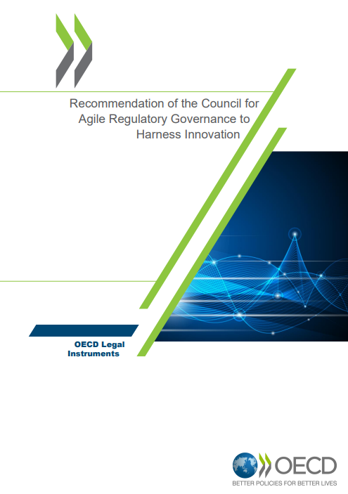
OECD 2021 Recommendation on Agile Regulatory Governance to Harness Innovation
In the face of economic, legal and social uncertainty resulting from innovation, public and stakeholder engagement is paramount for Adherents to fully understand the implications of technological advances, build trust and ensure that policy decisions are based on the best available evidence.
NEED for robust mechanisms for public and stakeholder engagement, including citizens and small innovative enterprises, from an early stage and throughout the policy cycle to enhance transparency, build trust and capitalize on various sources of expertise.

Slide 21
PRACTICAL GUIDANCE ON AGILE REGULATORY GOVERNANCE TO HARNESS INNOVATION:
Key priorities in developing robust SE
Structuring public and stakeholder engagement as an ongoing process.
Engaging with a full spectrum of stakeholders on a systematic basis, as well as foreign affected parties and other regulatory agencies.
Promoting transparency by defining clear government-wide policies on stakeholder engagement.
Considering more agile and effective ways of engaging with stakeholders (one-stop shops, digital communication methods…).
Enabling closer interaction between regulatory oversight bodies and stakeholders to improve regulatory quality.
Notes:
A clear overarching strategy that outlines how communication will take place, and what information will be communicated to stakeholders is important. The strategy helps to set community expectations about the channels and forms of communication that will be used. It can also be used to hold policy makers to account.
Examples:
The UK platform GOV.UK offers users the possibility to get emails about updates on specific topics (e.g. money, children, or education), webpages (e.g. news about certain departments, agencies), foreign travel advice webpages as well as news and communication. Both the UK and the French websites have a Facebook page information presenting the latest developments and procedures in an easily understandable and graphically appealing way. Source: (GOV.UK, 2022[7]) (ServicePublic, 2022[5])

Slide 22
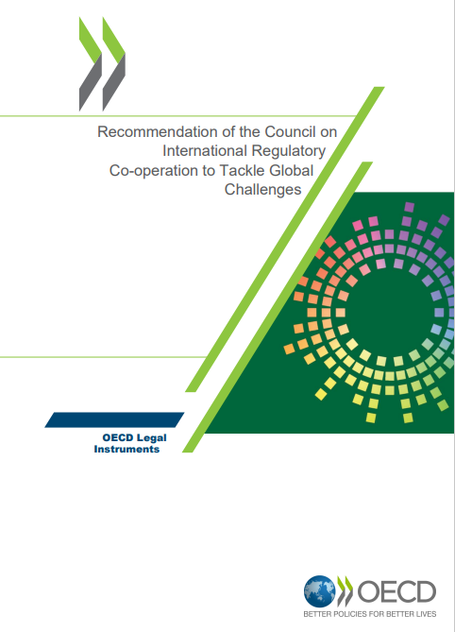
OECD 2022 Recommendation on International Regulatory Co-operation to Tackle Global Challenges
- What is IRC ?
International regulatory co-operation (IRC) refers to any agreement or organisational arrangement, formal or informal, between countries to promote some form of co-operation in the development, monitoring, enforcement, or ex-post management of regulation;
- IRC and stakeholder engagement:
IRC, throughout domestic rulemaking, allows for opportunities to engage with all parties, including potentially affected foreign stakeholders, to comment on potential impacts of proposed regulatory options beyond that jurisdiction’s borders and for such impacts to be considered;

Slide 23
OECD 2022 Recommendation on International Regulatory Co-operation to Tackle Global Challenges

Slide 24
3. Conclusion: Critical pillars for stakeholder engagement
Stakeholder engagement is key for evidence-based policy making
Effective and meaningful stakeholder engagement may be supported by:
A clear, cross-cutting policy
Engagement at each stage of life-cycle of regulation
Engagement with all interested and affected parties
Feedback about consideration given to inputs
Regular evaluation of stakeholder engagement policy and practices

Slide 25
Thank you!
For more information: www.oecd.org/gov/regulatory-policy
Marianna KARTTUNEN, Policy Analyst,
Regulatory Policy Division, OECD
Marianna.karttunen@oecd.org
Aida.rahmouni@oecd.org

