Slide 1
DEVELOPMENT OF E-COMMERCE IN TAJIKISTAN

Slide 2
OUTCOME
Our goals
Legal acts of Tajikistan
Our achievements on e-commerce
Main objectives of the Digital Economy
The main issues

Slide 3
The Objectives of Developing ICT and E-Commerce
highly qualified IT personnel
jobs for the population
improve the investment climate
share of IT in GDP
creating global IT products
intellectual potential of the youth

Slide 4
A list of legal acts of the Republic of Tajikistan that create a basis for the digital economy
The Law of the Republic of Tajikistan “On Public Services”
The Law of the Republic of Tajikistan “On Electronic Commerce”
The Concept of the Digital Economy
in the Republic of Tajikistan
the National Strategy for the Development of AI in the Republic of Tajikistan

Slide 5
Main objectives of the Digital Economy
Information society development
Creating conditions for transition to a completely new level of development, which will ensure the creation of a digital economy in the future
Transition to Government digital services
Improving the quality of life of the population through the use of digital technologies
Digital government
Implementation of digital technologies in the economy and social sphere
Increasing the country’s competitiveness
Additional GDP growth

Slide 6
The Law of the Republic of Tajikistan “On Public Services”
Rights and obligations of the service provider and service recipients
Requirements for the development of public service regulations
Informing service recipients about the procedure for the provision of public services
The procedure for assessing the quality of public services

Slide 7
The Law of the Republic of Tajikistan
“On Electronic Commerce”
The main directions of state policy in the field of electronic commerce
Rights and obligations of the seller and buyer
Legal force of e-documents and electronic messages in e-commerce
Features of registration of e-commerce contracts

Slide 8
Our achievements on e-commerce platforms and its well functioning models
C2C
B2B
G2C/G2B
B2B
B2C/C2B
alifpay.tj
alibobo.tj
wallet.dc.tj
аpostille.tj
arzon.tj
alifshop.tj
alifmobi.tj
eprocurement.gov.tj
pay.spitamen.com
b2b.tj
office.andoz.tj
evisa.tj
somon.tj
business.alif.tj
pay.andoz.tj
tajtrade.tj

Slide 9
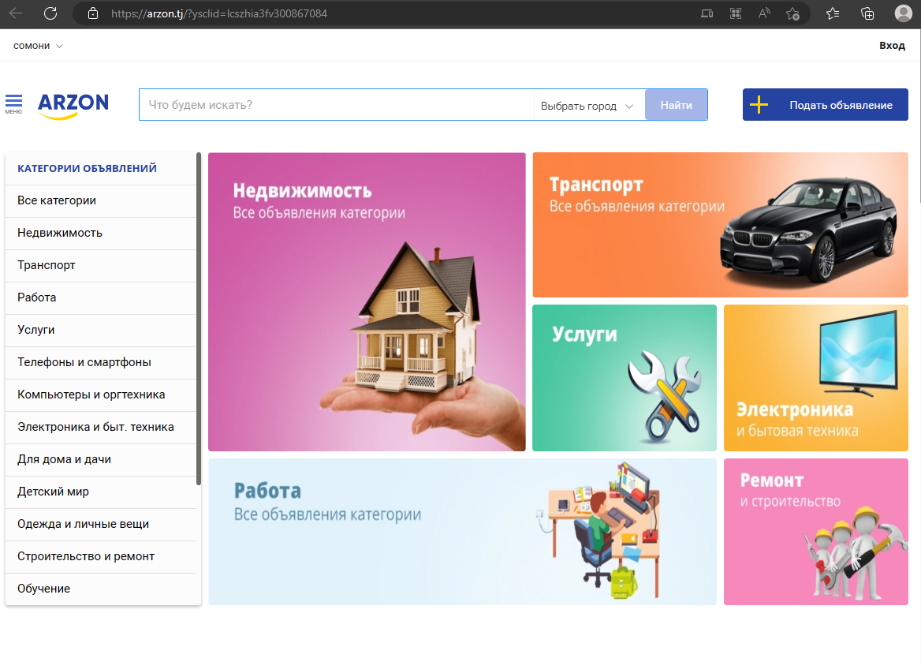
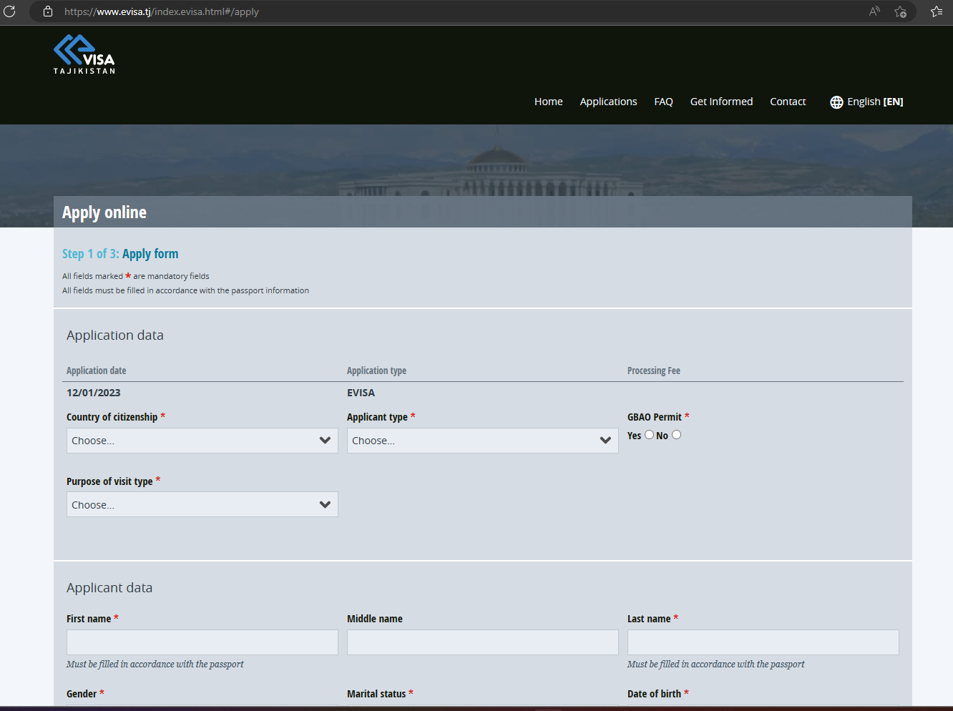
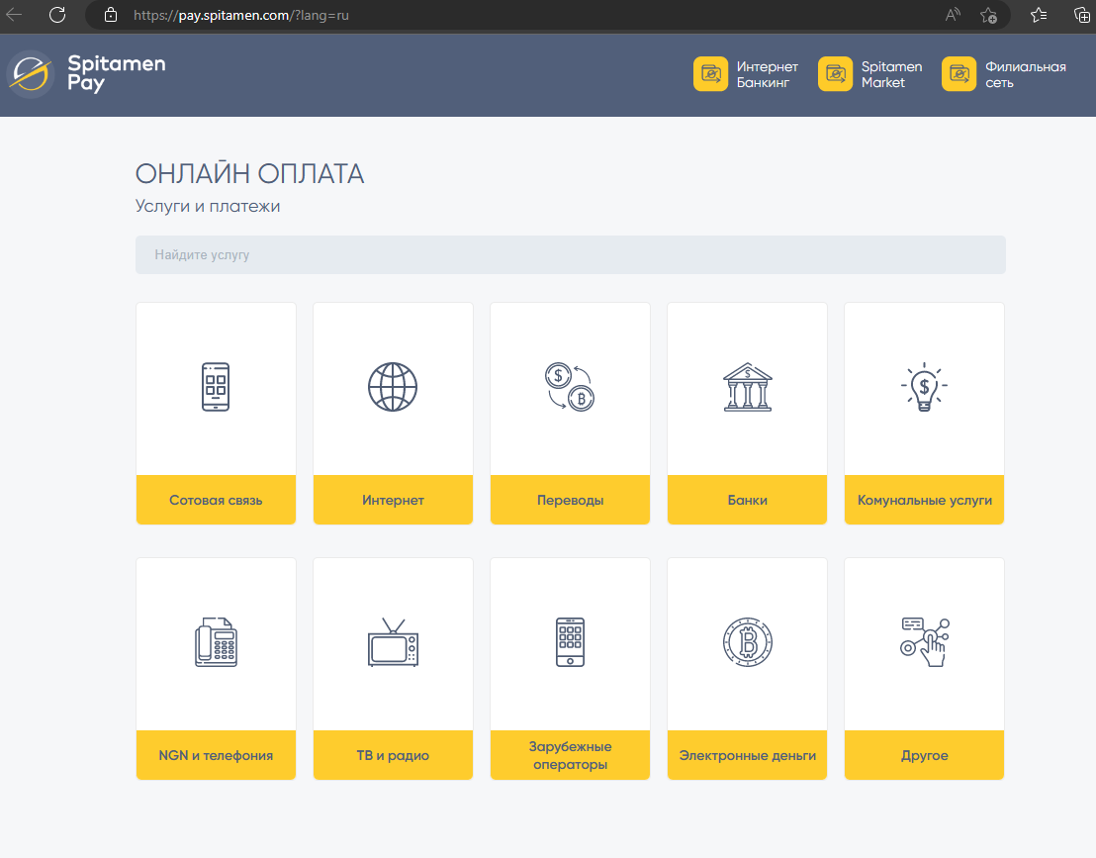
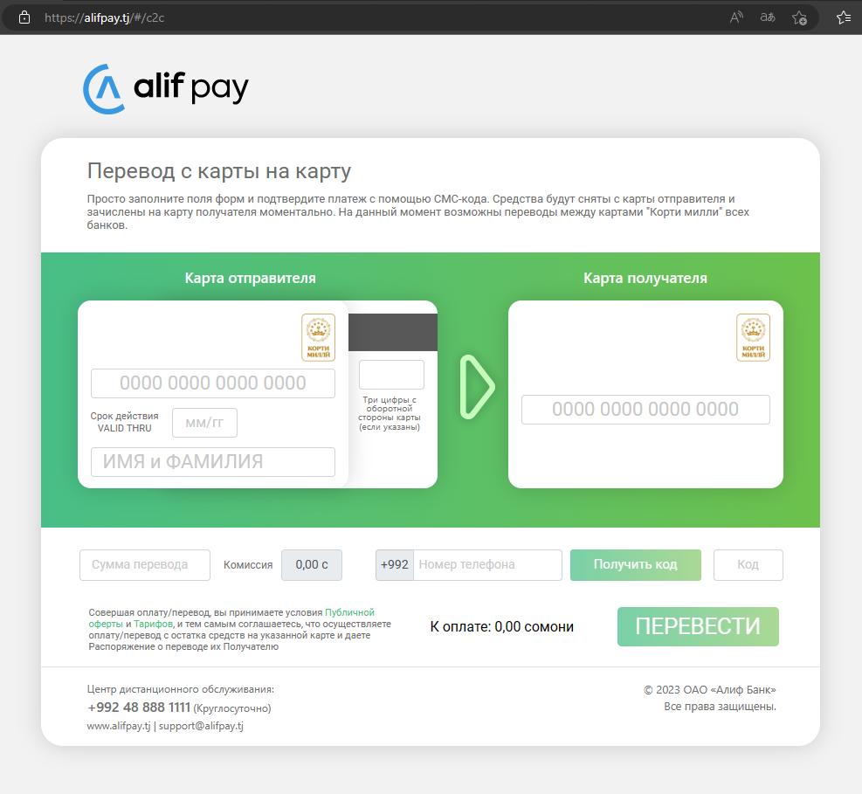
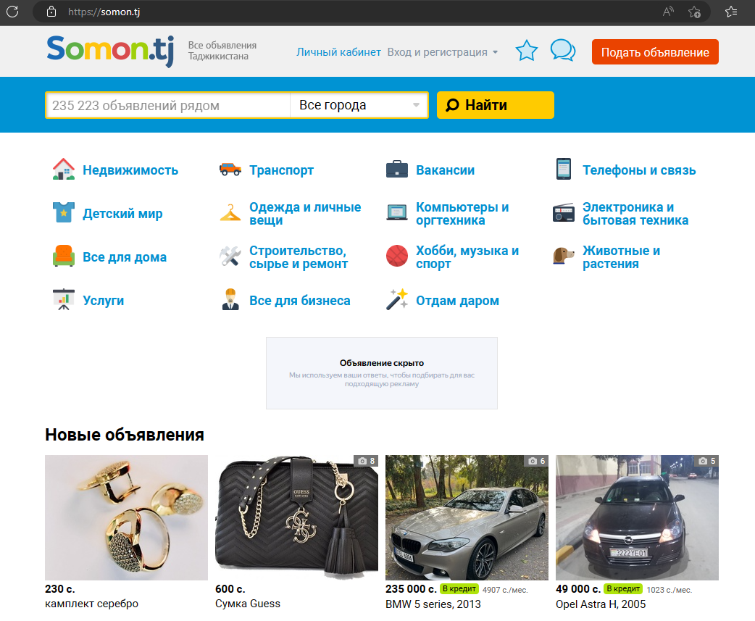
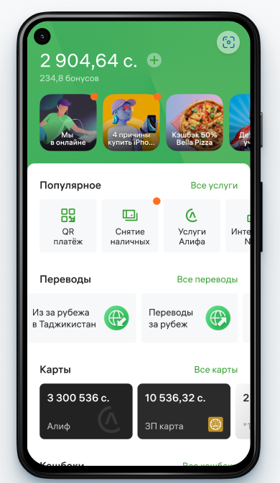
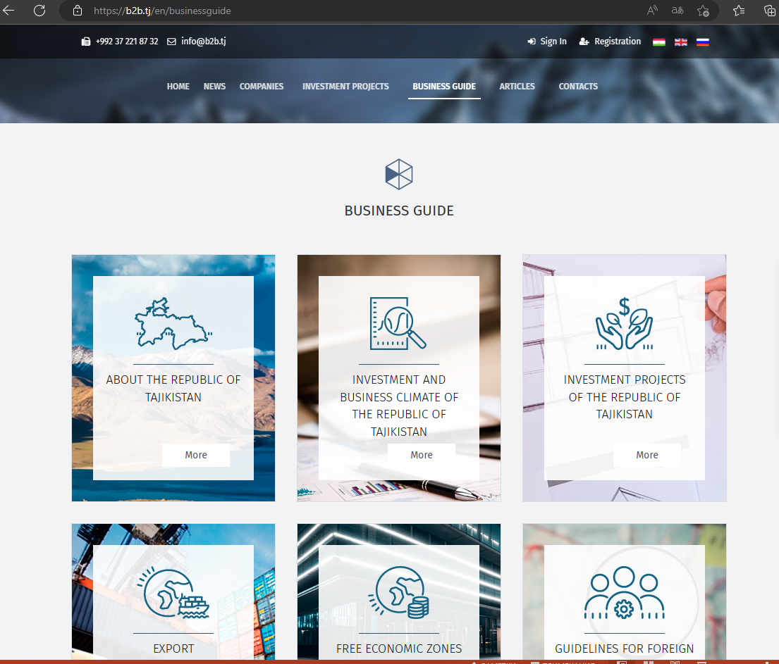
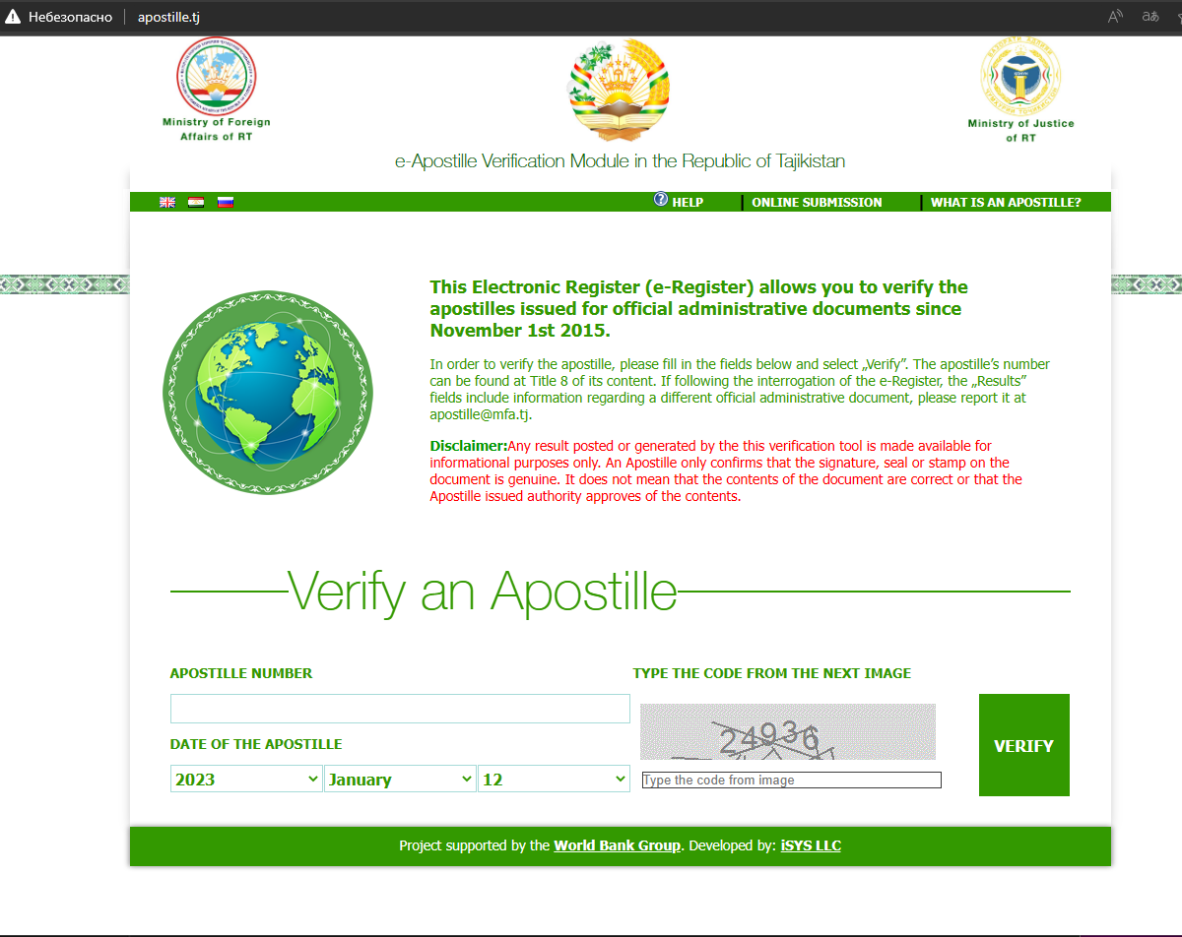
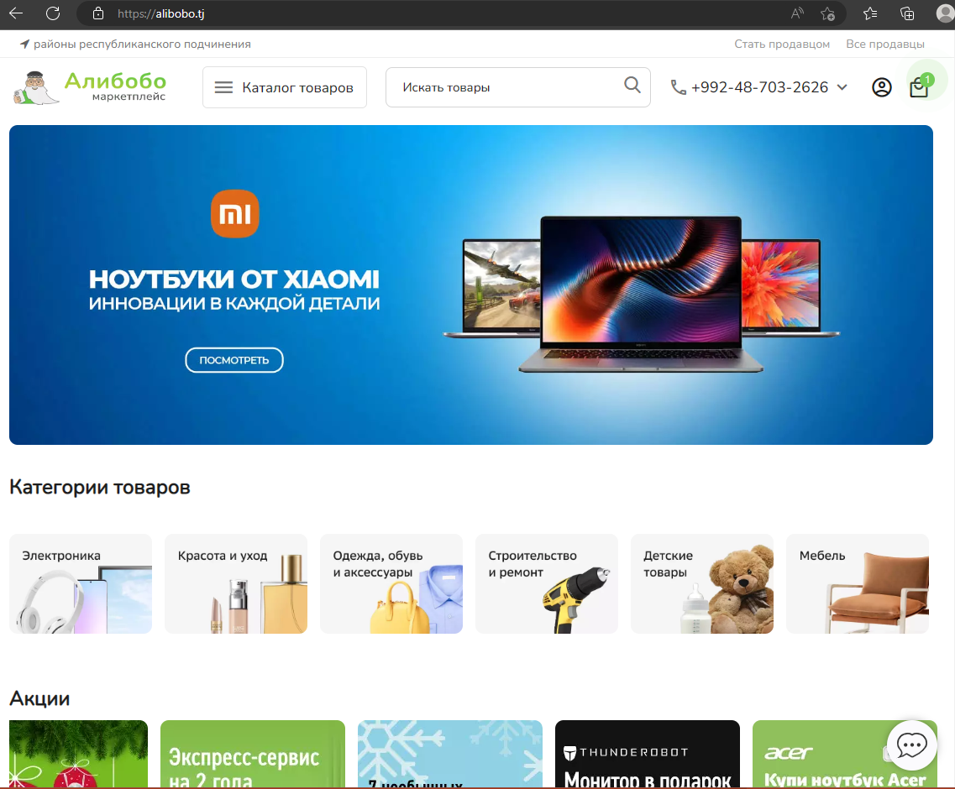
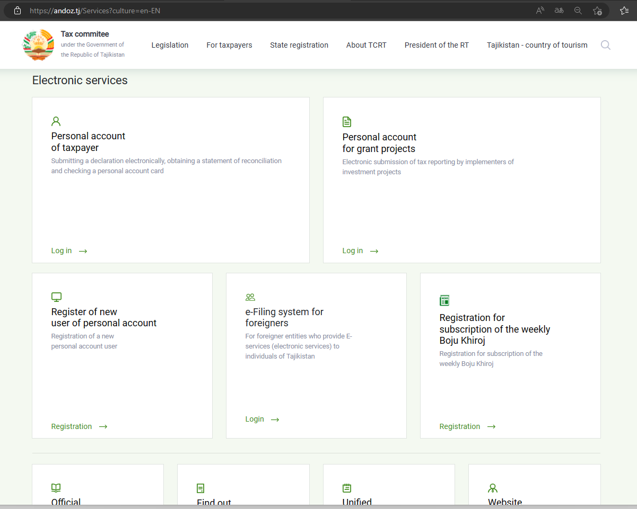
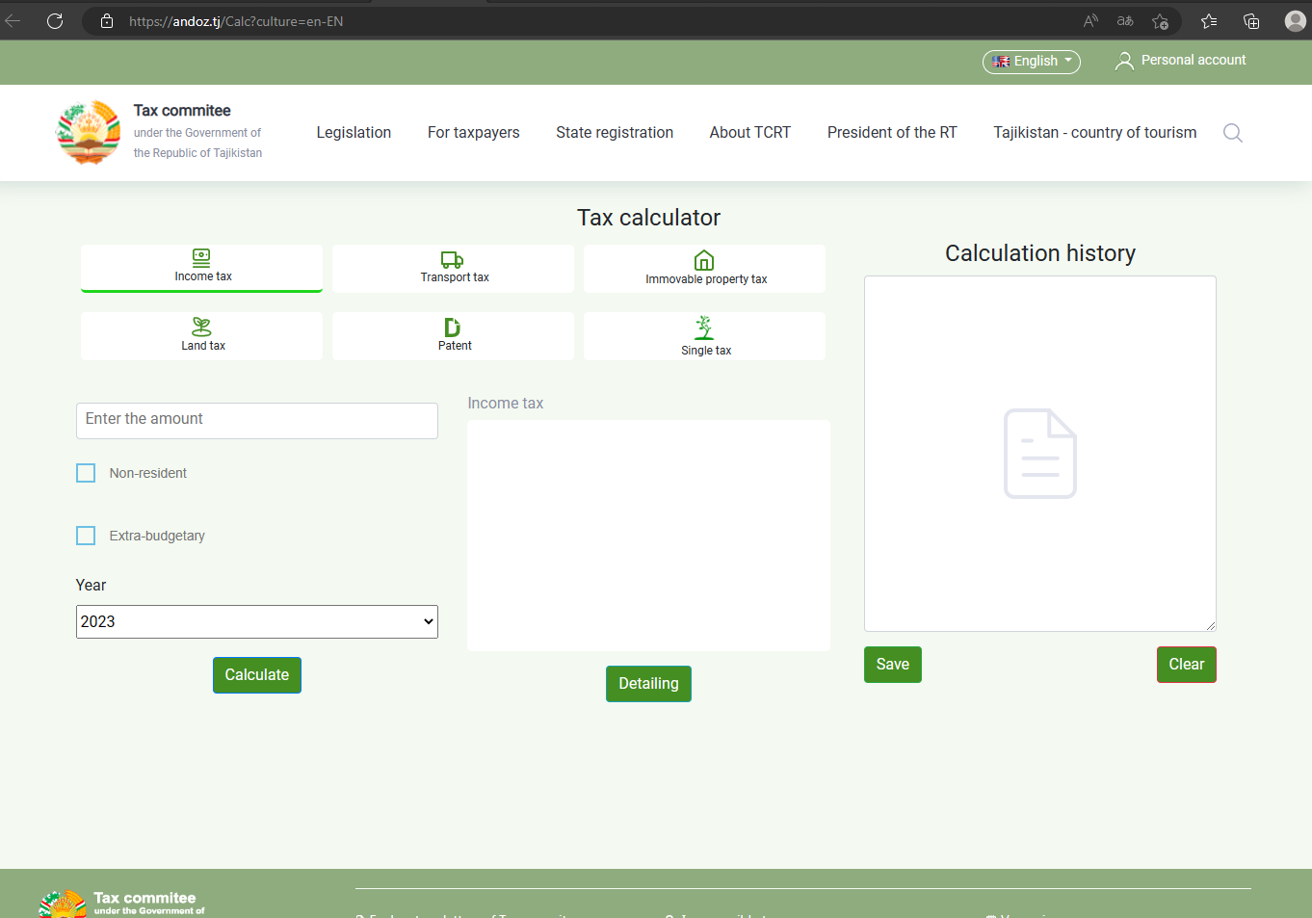
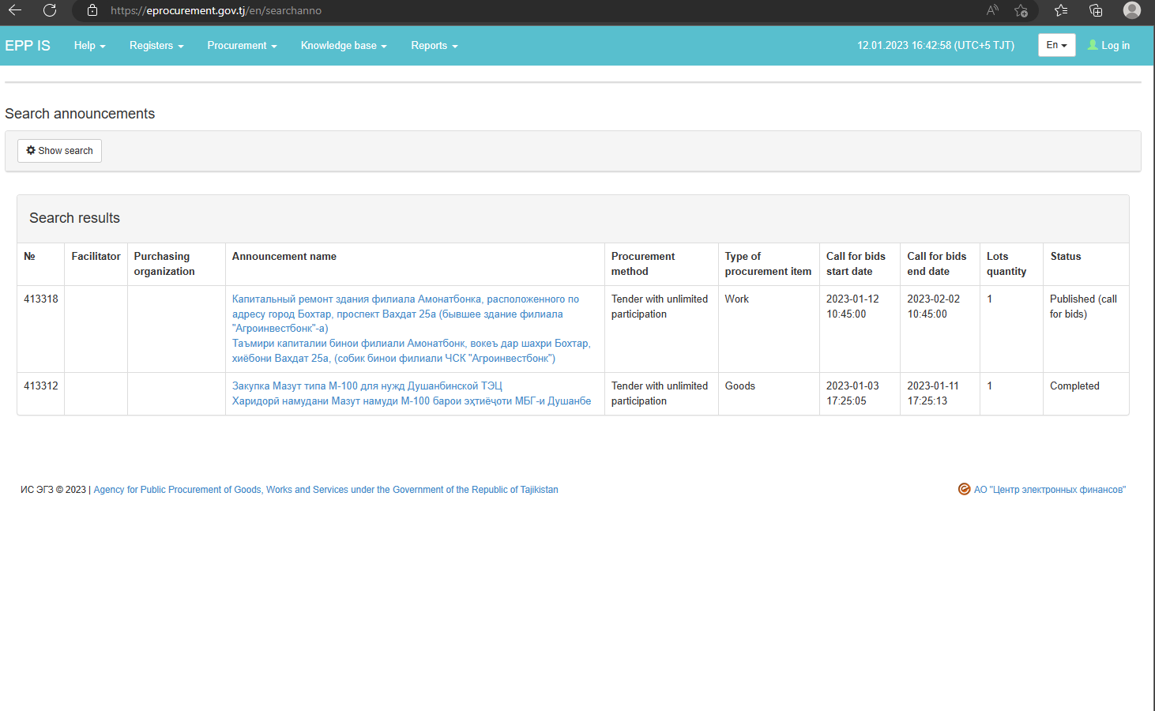

Slide 10
improving the access and quality of the Internet connection
continuous investment in creation of IT jobs
providing benefits and preferences for IT industries
The main issues for the development of the Digital Economy

Slide 11
THANK YOU FOR YOUR ATTENTION

