Slide 1


The Commercial Law Development Program
Presents
Public-Private Partnerships (PPP) Webinar Series
Project made possible through funding by:

Slide 2

PPP and Climate Risks
Part 3 - Management of Climate Risks Using PPPs

Slide 3



Today’s Presenters
Chris Kane P.E., J.D.
President
P3 Collaborative LLC
Washington DC-Princeton NJ
Patricia Sulser
International Development
Consultant
Former IFC Global Lead
IFC InfraVentures
John Buttarrazi
Adjunct Professor, Georgetown University
Founder, P3 Results LLC

Slide 4
Today’s Agenda
  Overview of Climate Action PPP Development
  Project Development (Identification & Feasibility)
  Procurement and Contracting
  Financing and Funding Plan

Slide 5
Overview of Climate Action PPPs

Slide 6

Climate PPP Project Categories
‘Climate resilience’ relates to the ability of a system to withstand, bounce back, or absorb the impacts of climate variability and change. Resilience is a quality or characteristic of a system.
‘Adaptation’ to climate change refers to an adjustment in a system in response to current or expected climate impacts. Adaptations can both be aimed at avoiding negative consequences or seizing positive opportunities from climate change.
Notes:
After Mitigation Climate Action projects fall into two primary categories, which overlap – Time is of the essence in most countries that are already oimpacted.
Need for a better project delivery approach (that is timely, flexible, iterative across all phases, and life cycle oriented)
Challenges in the anticipation and management of climate risks
Differences between mitigation, adaptation & resilience projects

Slide 7
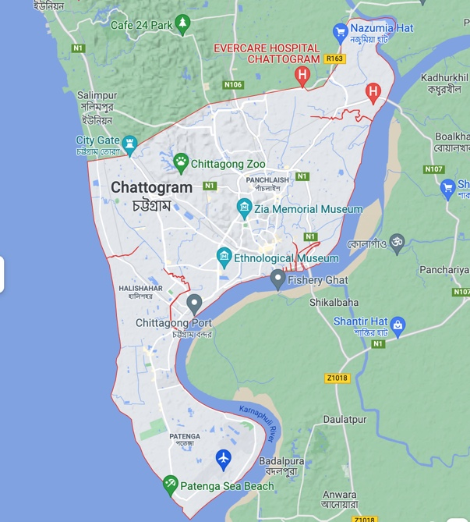
P3 and Climate Resiliency
Hypothetical Climate PPP Coastal Port- Chittagong, Bangladesh
Critical Port City and second largest city in Bangladesh
Severe & Increased Flooding from:
  Sea Level Rise;
  Storm Surge;
  Land Subsidence;
  Increased Precipitation
Limited Capacity to Deal with the problem effectively multiple gov’t entities, lack of funding, complexity
Notes:
Chittagram

Slide 8
Potential Scope for Chittagong Climate Action PPP
Levees along 30 miles as perimeter barrier around City
Storm Surge Protection (combination Green and Gray infrastructure)
Canal flood gates and dredging
Storm water management (retention structures and pumping stations)
Water, Power and Transportation System Protections

Slide 9
PPP Structure & Need for Good Advisors
Consultants for Feasibility Studies
Technical Advisors
Legal advisor
Financial Advisors
Owner
PPP Contractor
Development
Services
Design-Builder
Operator
DESIGNER/ SUBCONTRACTORS

Slide 10
Project Development

Slide 11
Feasibility Analysis - Checking Project Viability & Risk Mitigation
Pre-Feasibility and Feasibility studies are part of the project development cycle. Each country has its own policies on how to proceed with this.
The pre-feasibility study is a step to determine whether the projects identified are potentially viable and whether the additional time and resources should be invested.
A feasibility study takes that project a step further to look at how to mitigate risk and issues identified in the pre-feasibility stage and to determine viability.
Notes:
Pre-feasibility and feasibility analysis are both evaluation tools when determining viability for infrastructure projects.
What is the key difference between pre-feasibility and feasibility? Resources and time. Pre-feasibility analysis are faster and take less resources (money and internal capacity) and try to screen out projects with fatal flaws so that government can focus on projects that are more viable. Once screen, then feasibility analysis takes the project a step further with additional resources and time to develop detailed designs, funding and financing, and other factors of project viability.
Here is an example on the next slide.

Slide 12





Feasibility Analyses Assess 5 Key Elements
Pre-Feasibility
Feasibility
  Technical Solution and Cost
    Develop technical solution and rough order of magnitude
    Refine technical solution and finalize cost estimates
  Funding and Financing
    Identify funding gaps and identify potential funding sources
    Determine affordability and secure funding sources
  Policy, Legal, and Regulatory
    Survey regulations and laws and identify gaps and project concerns
    Review likelihood of required changes to laws and regulations for project success
  Environmental and Social
    Identify E&S “red flags” and develop mitigation strategy
    Conduct environmental and social impact assessment and mitigation strategy
  Commercial Structuring and Delivery Models
    Assess delivery model options, including PPPs
    Select delivery model and develop key commercial terms
IMPROVING THE LEGAL ENVIRONMENT FOR BUSINESS WORLDWIDE U.S. Department of Commerce | CLDP

Slide 13
Technical Feasibility Studies - create confidence & attract higher-end developers
Technical
Funding
Policy & Legal
E&S
Commercial
Conduct schematic/preliminary design and preliminary cost estimates
More detailed analysis of fuel risks (if any), availability, price and escalation
Review labor availability, risk of strikes, use of foreign labor
Review availability of utilities - water, power and communications
Conduct more detailed analysis of site, access, and subsurface conditions
Analysis of potential for flood and other adverse weather risk issues
    Coastal Flooding - Key Technical Questions:
    What should be the design criteria for sea level rise and storm surge?
    What should be the design criteria for storm intensity, sea level rise and future 500-year storm?
    What are the technology choices for both green and/or grey storm surge protection?
    What are the key risks regarding, site conditions, access and force majeure?
Notes:
AS YOU GET INTO THE FESIBILITY PHASE NEED BETTER DESIGN AND COST INFO
GO THRU LEFT
AS THESE FACTORS APPLY TO WEP

Slide 14
FUNDING - At the Feasibility stage, the focus is on affordability of the project
Technical
Funding
Policy & Legal
E&S
Commercial
Identify funding sources, which can include user-fees, tax/budget revenue, MDB lending, gas taxes, utilities payment, etc.
Compare cost and funding profiles over time to identify gaps in funding and then identify financing options to meet those gaps
Objective is to understand the affordability and begin securing funding sources
Evaluated rough-order-of-magnitude estimate with potential funding sources
    Climate Action Case Study– Key Funding Questions:
    What are the potential funding sources for the project?
    How much can the beneficiaries afford to pay for flood mitigation, particularly the business owners, Port and shippers?
    What is the estimated level of government contribution?
    Does the funding profile match the project cost profile?
    What financing sources are available to match funding with costs?
IMPROVING THE LEGAL ENVIRONMENT FOR BUSINESS WORLDWIDE U.S. Department of Commerce | CLDP
Notes:
At the pre-feasibility stage, the key objective is to determine if the project is affordable and the size of the funding gap.
The first step at this stage is identify potential funding sources, either government budget, special funds, or user fees. These choices are important as they have associated risks and also timing issue. For example, funding to the project from government budget is much certain and can provide funding upfront. However, user fees or future tax revenue are much more uncertain and cannot provide funding for construction upfront.
If project needs financing (securitizing/finance of future funding), pre-feasibility analysis should identify financing sources and options at this stage.
Again, the objective is to identify affordability gaps.

Slide 15

Policy & Legal – Enabling Legislation
Technical
Funding
Policy & Legal
E&S
Commercial
Key to choosing delivery approach
Analysis of applicable laws and regulations which can affect structure and incentives for private participation
Is there flexibility in procurement laws - “Best Value Procurement” is critical (price and other factors)
Rules for transparency & fairness
Anti-corruption laws and practice
Notes:
THE ENTIRE PROCUREMENT PROCESS NEEDS TO BE INVESTIGATED IN CHOOSING DELIVERY APPROACH,
IS THERE FLXIBILITY
ALSO RED FLAGS
BEST VALUE? Price and other factors, experience past performance partners, region, litigation
TRANSPARENCY AND FAIRNESS? Important to know investment in proposal, will be fairly considered, level playing field
ANTI CORRUPTION FCPA, UK

Slide 16
Technical
Funding
Policy & Legal
E&S
Commercial
Government needs a strategy to address E&S ISSUES that will deter international investors
Review environmental and social requirements, and the need for an environmental and social impact assessment (ESIA)
For international financing, governments should consider aligning the ESIA and management plans with the World Bank Envir. & Social Framework (ESF), IFC Performance Standards, etc.
    Climate Action Case Study– Key E&S Questions:
    What are key E&S risks and benefits and impacts to underserved communities that will be of concern to lenders?
    What are the local/national regulations for permitting, land acquisition, and resettlement?
    What kind of public consultations are pertinent

Slide 17
Commercial - Selection of Project Delivery
Analysis of Alternatives
Technical
Funding
Policy & Legal
E&S
Commercial
Design
Build
Operate
Maintain
(DBOM)
Master
Developer
Agreement
(MDA)
Design
Build
Finance
Operate
(DBFO)
Design
Build
Own
Operate
(BOO)
Design
Bid
Build
(D-B-B)
Long Term
Lease
Agreement
(Lease)
Design
Build (DB)/
CMGC
Public Projects
Public Private Partnerships
Concessions/Privatizations
Public Pays (taxes)
Public Sector Financing
Public Control
Public Funds
Greater Public Risks
Degree of
importance
Beneficiaries Pay (tolls/fees)
Private Sector Financing
Private Control
Private Equity
Greater Private Risks
IMPROVING THE LEGAL ENVIRONMENT FOR BUSINESS WORLDWIDE U.S. Department of Commerce | CLDP
Notes:
THE FEASIBILITY STUDY SHOULD DO AN EVALUATION OF ALTERNATIVE AND JUSTIFICATION FOR APPROACH RECOMMENDED
This schematic represents some of the variations in project delivery contracting approaches, THAT SHOULD BE CONSIDERED
PPPS THEMSELVES COULD HAVE VARIOUS FORMS
REVENUE RISK
FINANCING RESPONSIBILITY
ENVIRONMENTAL PERMITING RISK
FULL LONG TERM PERFORMANCE RISK
FORECE MAJEURE
Traditional on the left and privatization on the right
THIS EVALUATION NEEDS PRIVATE SECTOR INPUT, SINCE YOU NEEDS INTEREST IN RESPONDING AND COMPETITION

Slide 18
Procurement and Contracting

Slide 19
Procurement-- Competitive Tender Objectives and Requirements
  The Objective – Attraction and Competitive Selection of Government’s Private Partner
  Local Law and DFI Requirements: transparency, fairness, competition and value
  Parameters/Scope of Project– what duties and risks are being shifted to the private partner and what will remain a duty and risk of the Government around climate issues
  Standard Risk Allocation and Reasonable Risk-Adjusted Returns and Clarity as to Climate Events = essential
    Concession Agreement and other Project Documents will be appended to the Tender Documents
    Source of funding to pay private parties once the project is complete and operational must be clear from the outset
Notes:
NB: This section assumes that the government has already conducted preliminary feasibility studies and decided to pursue a PPP structure based on a rigorous Value for Money analysis with experienced advisors whose government clients have successfully attracted and sustained relationships with the private sector for important operations
Objective
1) The objective of the tender is key for the Government to have options and to select a quality private partner (a strategic investor) experienced in delivering projects specifically addressing climate and resilience objectives at an affordable price.
2) Parties– it is critical for the government to embrace the idea that, in contrast to a public procurement where the government will continue to own and operate the asset, in bringing in a private partner, it will not control the project as it would in a public procurement– the entity that will take responsibility for the project and be the borrower to lenders will be a private company, often an SPV. [Government may own shares in the Concessionaire but Concessionaire will be controlled by the private partner.] this feature of the PPP will be felt through the procurement process and the ultimate structure of the PPP.
3). Challenge: What will attract and incentivize private investors and lenders to partner with the Government and also protect and advance the interests of the Government/public. Tradeoffs and balance are key.
Applicable Law and DFI Requirements– Local procurement laws and Lender/DFI procurement guidelines are relevant. The World Bank Group's procurement process is guided by the principles of transparency, fairness, competition, and best value. The procurement process will be scrutinized by private investors and lenders for these factors.
Parameters/Scope of the Project: must be clear of what the private sector actors are expected and obligated to deliver—especially around climate change and resilience. Manage expectations of the parties.
Standard Risk Allocation and Reasonable Risk-Adjusted Returns– there should be a level of comfort that the risks to be borne by the private partner and its risk-adjusted returns are sufficient to attract bidders. Allocation or sharing of risks beyond what is in control of private party is key. Ultimately, government must be prepared to retain climate risks beyond those specifically allocated to the private partner
Source of funding to pay private parties-- If the project does not itself generate revenues (which is often the case with climate and resilience projects such as the Chittagong Port case study), what is the source of funds that will go to compensate investors and lenders? Taxes, User Fees, Exports, Bilateral and Multilateral Concessional Loans, Govt Bond offerings? Charitable contributions/relief, Non-traditional bilateral “donors”, Sovereign Wealth Funds

Slide 20
Procurement – Getting Ready–
Pre-Procurement Phase
Advisors—international advisers with specific track record of successes
Legal and regulatory environment and consensus building
Anticipate and mobilize/leverage resources for different project phases including sources of funding to pay and reward private partner and resources for managing the implementation of project as well as partnership
Value planning, design development, risk mitigation and realistic KPIs
Active management and consultations with potential strategic partners around risk allocation and commercial proposition –especially for climate and resilience projects given the unique risks involved
Form of PPP agreement to be decided (DBFOM etc)—and attached to the tender documents
Scope of the PPP to be decided, including climate and resilience features and residual risks and their relation to pricing
Type of procurement process to be decided—one-stage, two-stage, iterative, consultative or competitive dialogue
Notes:
Advisors--key
Legal and regulatory environment must allow for full private participation and risk-adjusted reasonable rates of return. Consensus building is key and ongoing.
Anticipate and leverage resources for the different phases of the procurement and project, including the procurement process
Active management and consultations with potential strategic partners around risk allocation and commercial proposition
Decision of form of PPP agreement
Determining the scope of the PPP including climate and resilience features
Process can vary in complexity but should be designed for success
Single-step tender
Iterative process involving many stages
Climate and resilience projects can and ideally should involve consultations with market and potential bidders—consistent with idea of PPPs focus on “outputs”

Slide 21
PPP Contractual Framework
The parties
The contracts
Why the contracts matter
Risk allocation under the contracts including Force Majeure Events and Climate Events
Rights and remedies (compensation) of the parties

Slide 22
The Parties to the PPP Contracts
The Public Sector (i.e. Government)--”Owner”:
  identifies needed public service
  defines service outputs/outcomes including around climate and resilience targets
  agrees long-term concession for the service
  payment made against performance measures
  imposes regulatory regime
The Private Sector– “Builder/Operator”:
  provides service;
  designs, builds, finances, operates and maintains the service and the assets
  must meet key performance indicators including climate and resilience objectives or risks lower revenues
  operates within regulated environment including “public interest” requirements

Slide 23
PPP Contractual Framework
Owner
Technical Advisors
Legal advisor
Financial Advisors
Lenders
PPP Contractor
Sponsors
Development
Services
Design-Builder
Operator
DESIGNER/ SUBCONTRACTORS
Notes:
Concession Agreement (or Project Agreement)
Design Build Agreement and other Project Agreements
Contracts and Cash Flows

Slide 24
Why the PPP Contracts Matter-Allocation of Risks and Regulation of Revenue Stream
Government Perspective
Private Partner Perspective
Investors’ and Lenders' Perspectives
Risk Allocation—generally according to which party is best able or willing to control/manage or assume the risk
Climate Risks—present new challenges to the standard risk allocation
Notes:
The PPP contracts are the means by which Government shifts obligations to the private partner/operator and rewards (or penalizes) it for its performance—timing, price, quality and ongoing performance.
The PPP contracts provide the contractual basis for the private partner to earn money to repay its lenders, to compensate its shareholders and earn risk-adjusted returns on its investment.
The PPP contracts are the means by which risks and rewards are allocated among parties—generally according to which party is best able or willing to control/manage or assume the risk-- benchmarking is important
While the government gives up a degree of control as a trade-off to crowd in private financial and technical resources, it retains the ability to terminate the PPP contracts for failure of a private player to deliver the asset or service on time, of a certain quality or not meeting agreed minimum performance criteria during operations.
Lenders often provide 70-80% of the costs of building the project and charge interest (at a relatively low return rate)
For PPPs, a common structure is for lenders to finance a single “project” or portfolio of assets, which is expected to generate sufficient revenues for the “borrower” to meet all its obligations (limited or no recourse to sponsor or other businesses after construction), and lenders share common pool of security (with access only to the “project” (all its assets and, esp. important, its licenses to operate, contracts) in case of EOD)
Arguably most valuable asset is right to build and operate the project
Lenders therefore concentrate on all of the factors and risks borne by their borrower (the Concessionaire) that will interfere with the ability of their borrower to repay its loans of termination of the Concession. The lenders seek to price their loans to reflect these actual and perceived risks. Hence the concept of extensive due diligence on the risks that are better borne by other parties and those risks that will be borne by the Concessionaire.
Equity investors (whether industrial, PE, VC, even impact investors etc) have hurdle return rates—also commensurate with actual and perceived risks—and investment horizons

Slide 25
Standard Risk Allocation—Lenders’ Risk Appetite
Concessionaire /Lender Risks | Government/Owner Risks
Commercial and Technical Risks Agreed scope of work around climate and resilience deliverables Localized labor strikes | Controlled by Government/Owner Government Defaults/Changes in Government Repudiation of PPP Contract Changes in Law or Regulations especially around pricing and taxes and increasingly around climate change directives and commitments Permits Foreign Exchange Expropriation Government credit or liquidity issues
Natural Risks (Insurable?) “Acts of God”, including lightning, fire, earthquakes, volcanic activity, floods, droughts, storms, cyclones, typhoons, tornadoes Epidemics, pandemics? | Not Controlled by Government/Owner War, sabotage, terrorism Country-wide labor strikes Resource risk? Environmental and climate risks beyond those specifically allocated to Concessionaire and not insurable Epidemics, pandemics?
Notes:
POLITICAL RISK INSURANCE IS AVAILABLE FOR SOME OF THE RISKS SUCH AS MIGA OR THE WB FOR
WAR AND POLITICALLY MOTIVATED CIVIL DISTURBANCE INCLUDING REVOLUTION, INSURRECTION, COUPS D’ETAT, SABOTAGE AND TERRORISM
EXPROPRIATION
FX INCONVERTIBILITY AND TRANSFER RESTRICTIONS
BREACH OR REPUDIATION OF CONTRACT
NON-HONORING OF FINANCIAL OBLIGATIONS

Slide 26
Force Majeure Events
Principle
  The PPP contracts are the means by which risks and rewards are allocated among parties—generally according to which party is best able or willing to control/manage or assume the risk
  Flexibility of contractual structure and parties’ commitment to the partnership is critical to accommodate inevitable challenges
  Climate events are testing the standard FME regime because they may be foreseeable and avoidable. Pressure to develop a more deliberate sharing of risk through conditions, covenants or indemnity provisions and not to rely on standard FME andn Change in Law risk allocation
Consequences of Force Majeure
    Extension of time for Concessionaire (and therefore for EPC/DB Contractor and Operator) to perform their obligations if Force Majeure causes delay.
    Increase to price in some instances if Force Majeure causes increased costs to EPC/DB Contractor or Operator.
    Termination if extended Force Majeure.
    Right to be Indemnified (bought out) in certain cases of termination for Force Majeure Events

Slide 27
PPP Contracts– Climate and Resilience Risk and Insurance or other Coverage
  PPP Contracts must each clearly delineate the parameters and technical specifications of the climate and resilience features Concessionaire is responsible to address.
  Everything else is a Force Majeure Event or delineated Climate Events, with relief for private parties and Government bearing the risk, or specific risk sharing and treatment for Climate Events.
  Insurability is a key risk mitigant– there are increasing types of insurance on the market now for climate events (including catastrophic events) and adaptability and resilience projects.
  Uninsured events—risks are typically borne by Government (or shared) if insurance or other risk mitigation products and instruments are unavailable

Slide 28
Concession or PPP Contract
Key provisions regarding climate change and resilience
  Government grants exclusive right for an agreed term to private company to design, build and operate the project. Climate and resilience obligations of Concessionaire must be set out in detail.
  Provides for financial and other relief for private partner in case of Force Majeure Events and compensation for Government defaults, Political Force Majeure Events, Changes of Law, Climate Events beyond those allocated to the Concessionaire
  Government must typically provide credit support backing its commercial obligations and those of SOE intermediaries that are party to a PPP contract (e.g., independent port authority). Particularly important where there is no apparent source of revenues.
  Government must be able to terminate for poor performance (failure of private partner to deliver or operate the promised quality project on time and budget)

Slide 29
Engineering, Procurement and Construction (EPC)/Design Build (DB) Contract
Key provisions regarding climate change and resilience
  EPC/DB Contractor agrees to design, engineer and build the climate and resilience “plant” for a specified, fixed price (subject to certain adjustments, e.g., Force Majeure or party defaults).
  EPC Contract prescribes the climate and resilience assets that are to be built with specificity. Needs to satisfy requirements of Concession Agreement so that there is limited risk of Concessionaire being in breach of the Concession Agreement.
  Completion Tests (requirements, procedures, etc.) spelled out in EPC/DB Contract—key is to ensure plant successfully delivers operational and reliable climate change and resilience assets that will be able to generate revenues (in the form of availability payments) expected by investors and lenders (and to preserve Concession Agreement).
  Provides for parallel financial and other relief for EPC/DB Contractor in case of Force Majeure Events and compensation for counterparty default and certain Force Majeure Events, including Climate Events beyond those allocated to or shared by the Concessionaire
Notes:
WILL NOT COVER THE FOLLOWING
If, upon completion testing, the plant is only slightly deficient relative to technical specifications and performance, completion can still occur, but EPC/DB Contractor pays performance liquidated damages to Concessionaire, which in turn it may be required to pay to Government under the Concession Agreement.
If the plant falls below an agreed threshold of performance, Concessionaire can terminate EPC/DB Contract, with damages payable by EPC/DB Contractor in sufficient amount to either repay debt, equity returns expected or often to allow Concessionaire to complete construction/remedy defects with another contractor.
EPC/DB Contract also provides plant is to be completed by a specified completion date. If plant satisfactorily completed but within an agreed period after target completion date, EPC/DB Contractor pays delay liquidated damages to Concessionaire (assuming no justifiable excuse, e.g., force majeure or breach by Concessionaire). If plant satisfactorily completed sufficiently ahead of target completion date, bonus often paid to EPC Contractor. These LDs are, in turn, payable by Concessionaire to the Government Owner under the Concession Agreement.
If plant not satisfactorily completed after sufficiently long period following targeted completion date in Concession Agreement and EPC/DB Contract, Concessionaire can terminate EPC/DB Contract (assuming no justifiable excuse).
Termination of EPC/DB Contract
By Concessionaire for extended failure to complete plant, plant performance significantly below technical specifications, material breaches by EPC/DB Contractor (beyond cure periods), or bankruptcy of EPC/DB Contractor.
By EPC/DB Contractor for payment failures, material breaches by Concessionaire (beyond cure periods), or bankruptcy of Concessionaire.
By Concessionaire or EPC/DB Contractor for extended Force Majeure.
Consequences of Termination of EPC Contract
If termination by Concessionaire for EPC/DB Contractor failure.
Concessionaire can replace contractor and deduct additional costs of completing plant from amount otherwise owed to EPC/DB Contractor for work completed. Concessionaire also entitled to any other damages or costs incurred (subject to certain limitations, e.g., no consequential damages, overall cap on liability, often 100% of EPC/DB Contract Price).
If termination by EPC/DB Contractor for Concessionaire failure.
EPC/DB Contractor entitled to payment for all work completed.
Plus any other damages or costs incurred (subject to certain limitations, e.g., no consequential damages).
If termination for extended Natural Force Majeure.
EPC/DB Contractor entitled to payment for work already completed.

Slide 30
Commercial Contract (e.g., Operations & Maintenance Agreement)
Key provisions regarding climate change and resilience
Concessionaire agrees to operate and maintain the climate and resilience project assets to meet detailed industry standards
Government agrees to pay for the O&M if it meets the contractual requirements at an agreed price.
  Clarity on Concessionaire’s duties and risks assumed—especially around climate events and resilience
  Project’s revenue stream
  Government ability to pay
  PRI or Partial Risk Guarantees may be required
  Affordability if relevant
Force Majeure Relief and Termination Rights to match other PPP Contracts
Notes:
WILL NOT COVER THE FOLLOWING.
Government protections:
Liquidated damages payable by Concessionaire to government and/or reduction in availability fees/tariff if assets are not built to agreed standards and technical specifications.
Right of Government to terminate. If assets are below a threshold of “contracted performance” or delays beyond targeted deadlines, Government has the right to terminate PPA.
Concession Agreement also usually provides work/plant is to be completed by a specified completion date, with liquidated damages payable from Concessionaire to Government Owner if work and plant are not completed by agreed date (assuming no justifiable excuse, e.g., force majeure or breach by Government Owner).
If completion does not occur after sufficiently long period following targeted completion date – Government Owner can terminate Concession Agreement (assuming no justifiable excuse).
Termination of O&M
By Operator, for payment failures, extended Political Force Majeure Events, material breaches by Government (beyond cure periods), or bankruptcy of SOE (if relevant).
By SOE Purchaser, for extended failure by Operator to complete works, performance deficiencies per tech. specifications (at completion or during operation) significantly below targets, material breaches by Operator (beyond cure periods), or bankruptcy of Operator.
By Operator or Government for extended Natural Force Majeure.
Automatically at end of term of O&M Agreement.
Force Majeure – events beyond the control of the party claiming inability to perform its obligations. Can affect construction and operations period risks
Can affect completion and therefore beginning of revenue production
Can affect operation of power plant and therefore interrupt revenues
Effect of FME—relief from being in default for failure to perform, permitted delays (and possible extension of the contract) and, depending on the nature of the FME, continued payments
Many natural events are insurable—but....climate events affecting adaptation/resilience assets may not be

Slide 31
Termination and Compensation
Termination Rights
    Government Default
    Concessionaire Default
    Extended Natural Force Majeure
    Political Force Majeure not compensated to Concessionaire or invalidating PPP Contracts
    Change in Law not compensated to Concessionaire
    Climate Events not allocated to or shared by Concessionaire

Slide 32
O&M - Termination/Indemnification Post-Completion
Events | Who can Terminate? | Obligation of Government Owner to buy the plant | Termination Payment from Government Owner | Payments for Concessionaire between Event and Termination | Other
Government Owner Default | Concessionaire | Yes | Debt and Equity and RoE (definitions of ROE vary) | Full Availability Payments based on what would have been possible
Concessionaire Default | Government Owner | Usually | FMV (at least equal to Debt) | Availability Payments with agreed reductions for failure to meet specified performance criteria
Political FM (and Climate Events beyond those specifically allocated to Concessionaire) affecting Concessionaire | Concessionaire | Yes | Debt and Equity and RoE | Full Availability Payments
Notes:
Construction:
- Non-Pol Force Majeure (e.g., earthquake, hurricane, fire)
- impacts Project Company and delays completion -------> no Capacity Payments until complete but no Liquidated Damages payable to Off-taker.
- prevents Off-taker from taking power, thereby delaying completion --→ Capacity Payments may still begin.
- If Political FM delays completion -----→ Capacity Payments begin.
Operation:
If Natural Force Majeure impacts Project Company and stops (or reduces) operation --→ Capacity Payments stop (or are reduced).
If Natural Force Majeure impacts Off-taker and stops (or reduces) operation---→ Capacity Payments continue.
If Political FM stops (or reduces) operation -----→ Capacity Payments continue unreduced.
If Political Force Majeure increases Project Company’s costs, additional costs are passed on to the Off-taker.
For extended Force Majeure.
* If Natural Force Majeure, either can terminate.
* If Political Force Majeure, Project Company can terminate.
Note, may be different outcomes where Off-taker not government owned entity(e.g., captive power plants).
Note, role of insurance(delay in start-up, business interruption, and property/casualty) to mitigate Natural Force Majeure risks.
Default Termination:
If termination by Project Company for Off-taker default(same as Political Force Majeure), typically right to “put”plant to Off-taker. “Put” price to cover all debt, return of and on equity, plus costs.
If termination by Off-taker for Project Company default, often right to purchase plant not always obligation to purchase (stranded asset risk). Less relevant where Project can sell to spot market or industrial clients. Lower “put” price but still sufficient to cover debt.
If termination for extended Natural Force Majeure, sometimes “put” and “call” rights. Casualty insurance provides protection.
If termination at end of term of PPA, frequently plant transferred to Off-taker (often at nominal or reduced price).
Re solar and wind especially, often without capacity payments (i.e., energy only), feed in tariffs with subsidy elements which heighten the change of law risk.

Slide 33
PPP - Termination Chart, Post-Completion
Events | Who can Terminate? | Obligation of Government Owner to buy the plant | Termination Payment from Government Owner | Payments for the Concessionaire between Event and Termination | Other
PFME affecting Government Owner | Concessionaire (dovetailing with period during which Government Owner must make deemed Availabilty Payments) | Yes | Debt and Equity and ROE | Full Availability Payments
Natural FME affecting Government Owner | Concessionaire after period of time during which Government Owner must make deemed Availability Payments | Yes, reduced by insurance proceeds | Debt and Equity, sometimes also some ROE | Availability Payments reduced by deficient performance (insurance to be carefully designed to cover most Natural FME
All other FM affecting Company | After extended period and inability to restore if required, Off-taker or both | Not necessarily but Govt might opt to buy—flexibility on price | Flexible or no | Reduced or no Capacity and Energy Complemented by Insurance | Agreement to rebuild
Change of Law | Company | Yes | Debt and Equity and RoE | Capacity—sometimes Energy too | Usually leads to adjustment of capacity payment rather than termination if CIL only results in increased costs (vs. invalidation)

Slide 34
Finance and Funding Plan

Slide 35
Overview of Climate Finance
Climate Finance: financial resources invested in mitigation and adaptation measures through financial instruments including loans, grants and guarantees, which have helped leverage additional private finance
Sources: public, private & intermediaries
Instruments: range of tools, mechanisms and modalities
Uses: mitigation vs. adaptation

Slide 36
Private Sources & Intermediaries
Project Developers: national/regional utilities, independent power producers, renewable energy
Corporate Actors: manufacturers, corporate end-users
Private Households: family level economic entities, high net worth individuals
Institutional Investors: insurance companies, pension funds, endowments
Commercial Financial Institutions
Private Equity, Venture Capital & Infrastructure Funds

Slide 37
Public Sources & Intermediaries
Ministries & Government Agencies
  Bilateral Aid agencies
  Export Credit Agencies
  UN institutions
Development Finance Institutions
  Multilateral Development Banks (MDB)
  National Development Banks (NDB)
  Bilateral Financial Institutions (BFI)
Climate Funds
  Global Environment Facility (GEF)
  Adaptation Fund (AF)
  Climate Investment Funds (CIF)
  Green Climate Fund (GCF)
  National strategies & policy frameworks conducive to investment
  Technical assistance, financial instruments & specialized knowledge
  Grants & loans at concessional terms (finite lifetime, sectoral focus)

Slide 38
Uses of Climate Financing
91% mitigation
Renewable energy generation
7% adaptation
Water supply management
Climate-resilient infrastructure
Coastal protection
Disaster risk reduction
AFOLU & natural resource management
AFOLU & livestock management
Sustainable transport
Energy efficiency in industry and buildings

Slide 39
Climate Financing Instruments to Leverage Private Sector Investment
  Policy Incentives:
  Feed-in tariffs
  Tradeable certificates
  Tax incentives
  Clean energy subsidies
  Risk Management:
  Guarantees
  Insurance policies
  Contract-based instruments
  Grants:
  Cash transfers
  In-kind support
  Low-cost project debt:
  Concessional loans
  Capital Instruments at commercial terms:
  Project-level market rate debt
  Project-level equity
  Balance sheet financing
Address investor-specific needs
Align public and private interests
Enable scaled-up investments

Slide 40
Summary and Conclusions
Climate Action PPPs during Feasibility Phase Need To Figure Out The Design Criteria for the Uncertain Future
Once the Design Criteria is Agreed to the Parties Must Conduct a “Realistic Risk Allocation” Strategy to Attract Developers/Investors
The Procurement Stage is Vitally Important in Setting the Stage For Success
Innovative Financing is Required to Put Together a Financing Plan that is Bankable
….

Slide 41

Previous Webinars
Project Finance
Screening Tools
Pre-Feasibility Studies
Pre-Qualification and Evaluation
Sector Specific: Pre-Feasibility Studies
Business Case Development
Unsolicited Proposals
Financial Modeling
Life Cycle Costs Analysis
Project Agreements
Financing Documents
Commercial Contracts

Slide 42
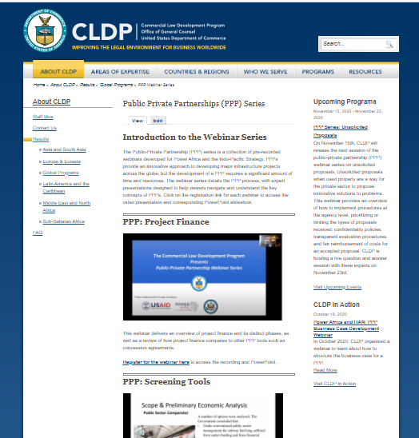
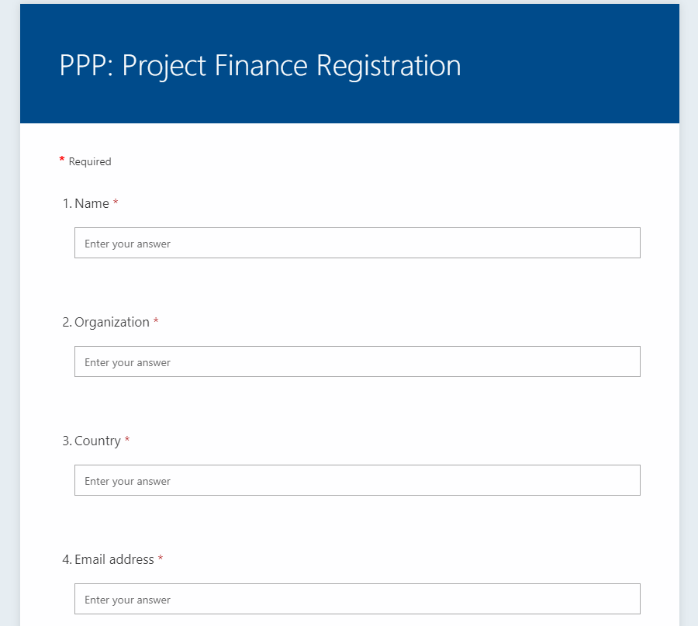
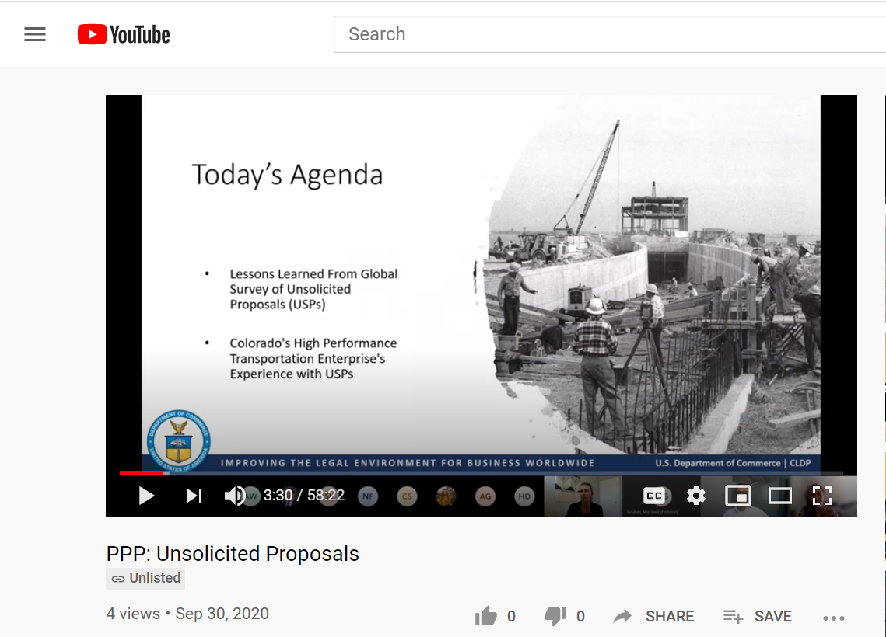
Access Previous Recordings
  Go to: www.cldp.doc.gov/PPP
  Register
  Watch

Slide 43
Upcoming Webinars
Foreign Exchange Risk
Sovereign Debt
Contact Management
Social PPPs
Airport PPPs
Dispute Resolution
Negotiations

Slide 44






1401 Constitution Avenue, NW, Washington, DC 20230
Tel: +1 202 482 2400
www.cldp.doc.gov
Mohammed Loraoui
Attorney-Advisor
Power Africa Portfolio
Mloraoui@doc.gov
Shane Meckler
Attorney-Advisor
Indo-Pacific Portfolio
Smeckler@doc.gov

